Slide 1
EDFR 6300 Final Project Rubi Perez

Slide 2
Introduction
Purpose- The purpose of the literature review is to investigate the relationship between screen time and development and learning in preschool students. The reason why I decided to focus on preschool students is because early childhood education sets the foundation for the upcoming years of learning.
Problem- The investigation focused on the effects of screen time on development and learning.

Slide 3
Research Questions
1. How does screen time affect cognitive development?
2. How does screen time affect language development?
3. How does screen time affect sleep patterns?
4. How does screen time affect emotional development?

Slide 4
Introduction
Background/existing Knowledge-
Early education is my area of expertise and through previous classes , I have come across the importance of early education. Such as activist Diane Ravitch, who was an assistant secretary of education for the United States mentions that the federal government should invest in early childhood education.
Article investigates the impact of early childhood

Slide 5
Methods for finding the articles
Information was gathered from different peer reviewed articles that were found in ERIC and Google Scholar. The articles were chosen based on their relativity to the research questions. Abstracts were read for various articles to identify the relationship between variables associated with the research questions. There were four studies that were selected based on their research methods and results that were found very relatable to the research.

Slide 6
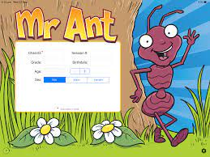
Article 1 How does screen time affect cognitive development?
Methods
Participants were 97 preschoolers ages 3-5 in Alberta and Ontario Canada. The amount of screen time was assessed by using a parental questionnaire. Cognitive development was evaluated by examining expressive vocabulary and working memory. These were evaluated by using an Early Years Toolbox with the task of “Mr. Ant.” Statistical analysis was performed by using SPSS version 26.0. Null models were used to find correlation between cognitive development and screen time.

Slide 7
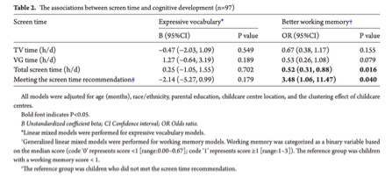
Article 1 How does screen time affect cognitive development?
Results:
The P Value allows us to distinguish the probability under the assumption of no effect or no difference (null hypothesis.)
None of the screen time variables were associated with expressive vocabulary. Regarding working memory, there were no significant associations for TV time or VG time. However, higher total screen time was associated with lower odds of having better working memory. Working memory has a huge impact on the ability to learn.

Slide 8
Article 2 How does screen time affect language development?
Methods
Participants were 164 monolingual Finnish-speaking children aged 2.5 to 4.1 and their mothers. Mothers completed “The Screen Time Questionnaire” to evaluate the children's screen time. Language development was measured by lexical, phonological, morphological, repetitive, and general abilities using a Finnish version of the MacArthur Communicative Development Inventories III to conduct a phonology and morphology tests. IBM SPSS statistics, version 26 for Windows was used to analyze the data. The level of significance was 0.05 in all the analyses.

Slide 9
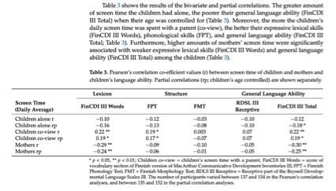
Article 2 How does screen time affect language development?
Results
Negative relationship between the variables.

Slide 10
Article 3 How does screen time influence sleep patterns?
Methods
Participants were 754 children (52% girls), aged 2-5 years old. Questionnaires were given to investigate the child’s sleep regime and screen time. Children’s sleep problems and emotional reactively were assessed using a Lithuanian version of the Child Behavior Checklist. Analysis was created using SPSS 23.0 and SPSS Amos 19.

Slide 11
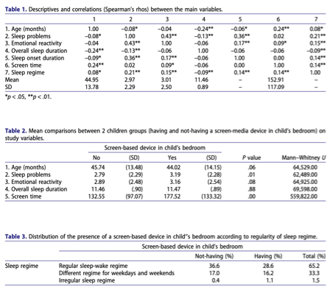
Article 3 How does screen time influence sleep patterns?
Results
Sleep problems were positively associated with emotional reactivity, sleep onset duration, and a lack of sleep regime, as well as were negatively related to overall sleep duration.

Slide 12
Article 4 How does screen time influence emotional development?
Methods
Participants were narrowed down to 365 children ages 4 and their mothers. This was a 4-year longitudinal study. The present study reports data and results of two assessment waves after the T₀ of the original study (children aged 4 years): T₁ (children aged 6 years), T₂ (children aged 8 years). At T₁ and T₂: children’s teachers completed the Teachers Report Form including the competence part to evaluate academic achievements Bivariate Pearson correlation analyses were performed on the whole sample to verify possible associations between all variables.

Slide 13
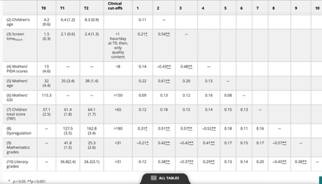
Article 4 How does screen time influence emotional development?
Results
Bivariate Pearson correlation allows us to see the relationship between the variables in the study.
Notably, children’s screen time increased over time and dysregulation significantly increased from T1 to T2. In addition, math and literacy grades dropped over time.

Slide 14
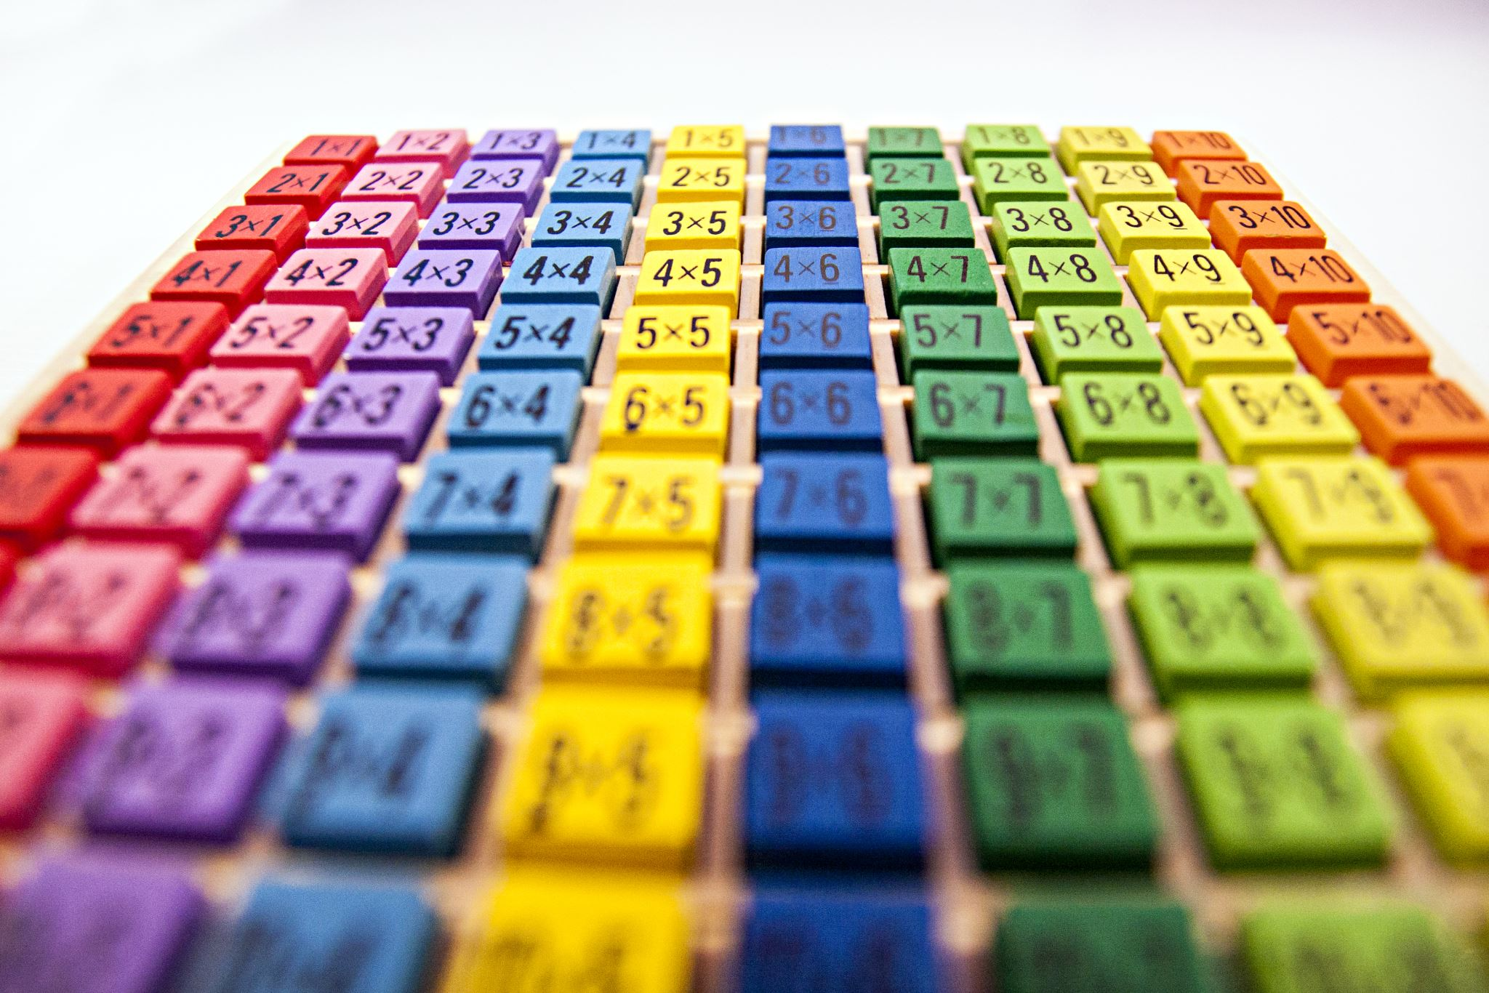
Discussion
Findings
All articles show a negative correlation between the variables specified. (screen time vs. cognitive development, language development, sleeping patterns, and emotional development)
Conclusion
I conclude that high amounts of screen time have a negative effect on development and learning.

Slide 15
Discussion
Implications
This information will help me explain to students and parents the negative effects that screen time can play in their lives. It will also help me guide students and parents on what an appropriate amount of screen time can be and how to use technology wisely.
Limitations
Research questions – more specific/ less questions
Articles used for the review
Conducting an experimental study with a more relatable sample population

Slide 16
Learned in class
Variables (independent, dependent)
Instruments used to collect data
Sampling
Quantitative vs qualitative
Data analysis
Reliability and validity

